Slide 1
Examination Timetabling Automation using Hybrid Meta-heuristics Mid term thesis presentation
Instituto superior de engenharia de lisboa
Computing engineering
Student: Miguel Nunes
Supervisors: Artur Ferreira
Nuno Leite

Slide 2
Index
Introduction Timetabling problem
Types of approaches
ITC2007 Examination timetabling problem
System architecture
Loader e solution initialization
Proposed approach: Local Search
Results

Slide 3
Educational Timetabling problems
Examination Timetabling
Course Timetabling
School Timetabling
Applied constraints can be hard or soft

Slide 4
Objectives
Generation of timetables according to the ITC 2007 (International Timetable Competition) - examination timetabling track
Timetable validator
Graphical User Interface

Slide 5
Timetabling problem
Two possible formulations:
Search problem
Optimization problem
Possible types of solutions:
Feasible
Non feasible
Optimal
Sub-optimal

Slide 6
Some types of approaches
Exact algorithms
Graph Coloring Based techniques
Single-solution based meta-heuristics
Population based meta-heuristics

Slide 7
Exact algorithms
Search the whole space of solutions
It is guaranteed that an optimal solution is found
Inappropriate for large sized problem instances
Algorithms
Branch-and-Bound
Constraint-Programming

Slide 8
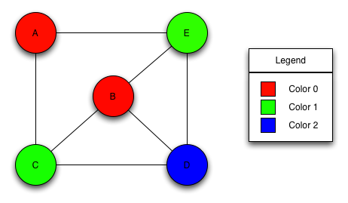
Graph Coloring Based techniques
Assign the minimum set of colors to an element type of the graph following certain constraints
Examples of Graph Coloring problems:
Vertex Coloring
Edge Coloring
Timetabling problems can be reduced to a graph coloring problem

Slide 9
Meta-heuristics
Provide solutions for optimization problems
Used in timetabling problems to optimize feasible solutions provided by heuristics
Sub-types:
Single-solution meta-heuristics
Population-based meta-heuristics

Slide 10
ITC 2007 Examination timetabling problem
12 different datasets
Ranking depends on the distance to feasibility and fitness values
The benchmarking program limited this project’s execution time to 225 seconds
The hard constraints are the following:
No student must be in more than 1 exam at the same time
Room’s capacity must not be exceeded
Exam’s length must not surpass the assigned time slot’s length
Exams hard constraints must be followed (e.g., 1 AFTER 2)
Rooms hard constraints must be followed (e.g., 1 ROOM_EXCLUSIVE)

Slide 11
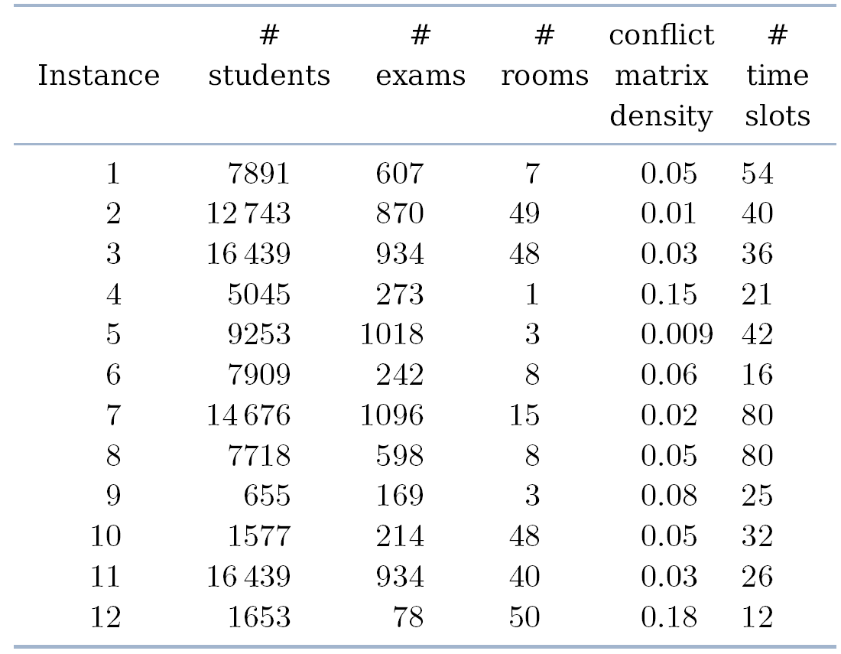
ITC 2007 Examination timetabling problem

Slide 12
ITC 2007 Examination timetabling problem
The soft constraints are the following:
Two exams in a row/day
Period spread
Mixed durations
Larger exams constraints
Room penalty
Period penalty

Slide 13
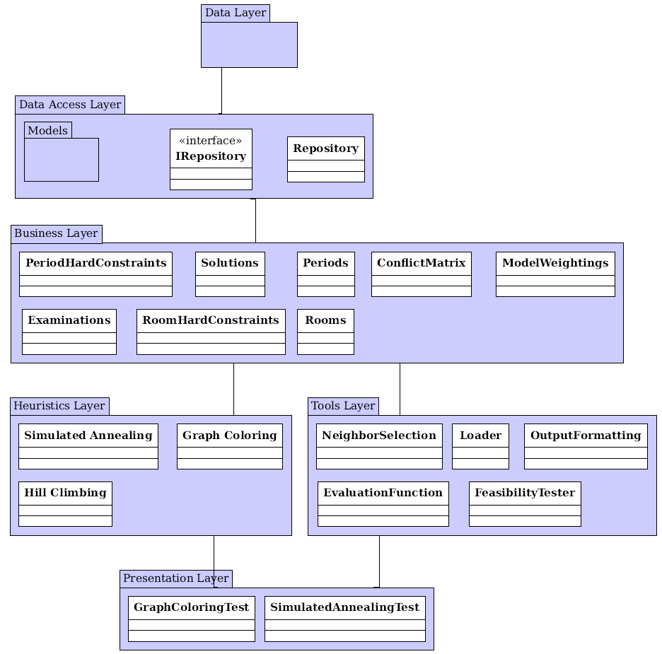
System architecture
Data Layer
Stores all entities
Data Access Layer
Provides repositories to access the stored entities
Business Layer
Provides functionalities to manipulate the repositories
All business classes implement the Singleton pattern
Tools Layer
Tools used by the Heuristics Layer and lower layers
Presentation Layer

Slide 14
System phases
Graph Coloring
Simulated Annealing
Hill Climbing
Examination Timetable

Slide 15
Loader
First phase on the project execution
Loads all the information from the dataset
Creates and populates the conflict matrix
Each dataset contains all the information required to create a solution:
Examinations and students’ attendings
Rooms, their capacities and penalties
Periods and their penalties
Period and room hard constraints (optional)
Soft constraints

Slide 16
Graph Coloring
The method used is the Largest Degree Ordering method
The heuristic used to generate a feasible solution
The implementation was divided in four phases:
Adds the exclusion hard constraints to the conflict matrix
Erases all examination coincidence hard constraints’ occurrences that have student conflicts
Populates and sort the assignment lists:
Unassigned examinations with room exclusivity hard constraint
Unassigned examinations with after hard constraint
Unassigned examinations with examination coincidence hard constraint
All other unassigned examinations
Examination assignment.
Normal assignment
Forcing assignment
230
110
422
75
621
954
13
755
18:04:2005
E: 107 R: 2
E: 202 R: 1
19:04:2005
E: 2 R: 5
20:04:2005
E: 112 R: 6
E: 254 R: 1

Slide 17

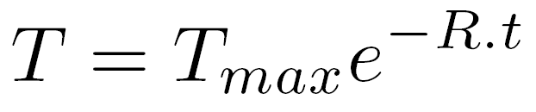
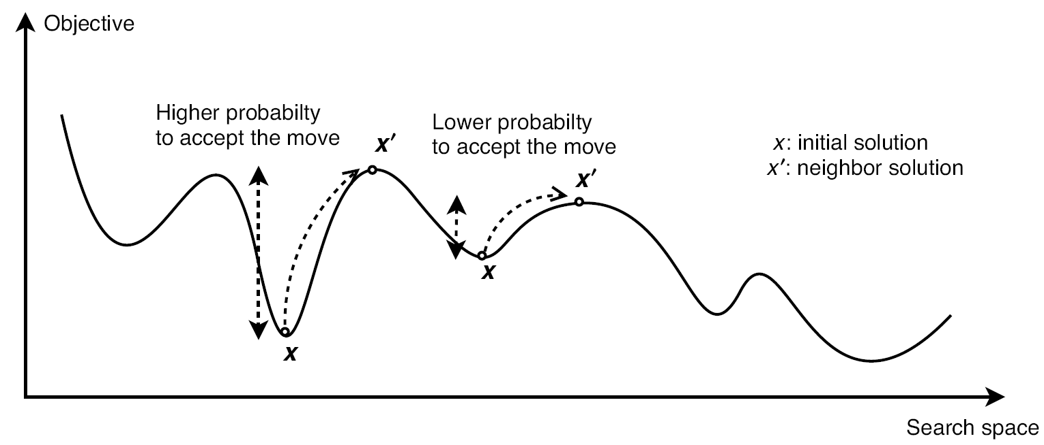
Simulated Annealing
Neighbor operators generate neighbor solutions
Neighbor solutions’ acceptance criterion:
Exponential (decreasing) cooling schedule:
Parameters used in this meta-heuristic:
Maximum temperature
Minimum temperature
Number of iterations per temperature value
Temperature decreasing rate

Slide 18
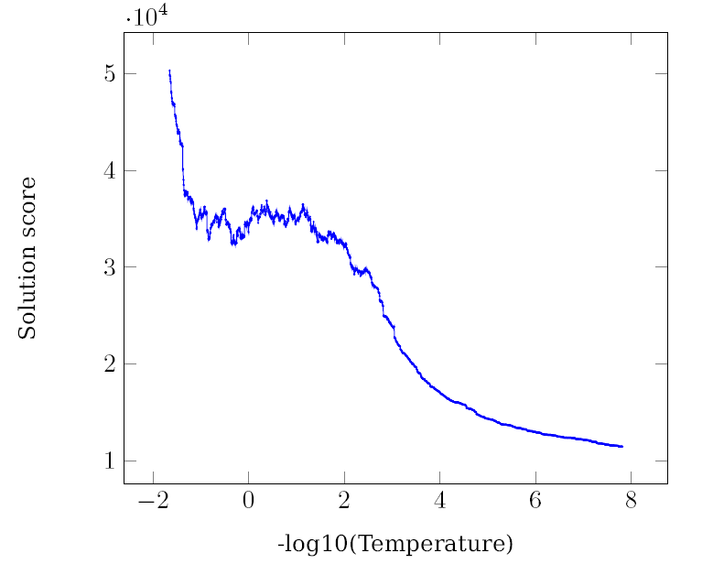
Simulated Annealing
Parameters : TMax = 45, TMin = e⁻¹⁸, loops = 5 and rate = 0.01
Results:

Slide 19
Hill Climbing
Uses the same neighbor operators as the SA
Only accepts better solutions
It is time-monitored
Used to guarantee that the project is finished within the given time limit

Slide 20
Neighborhood Operators
The neighborhood operators are randomly chosen to be used:
Room Change;
Period Change;
Period & Room Change;
Room Swap;
Period Swap;
Period & Room Swap.

Slide 21
Experimental Results
The results were obtained by averaging the 10 runs for each dataset
The parameters used to run the SA were:
TMax = 0.01
TMin = 1e⁻¹⁸
reps = 5
rate = 0.001

Slide 22
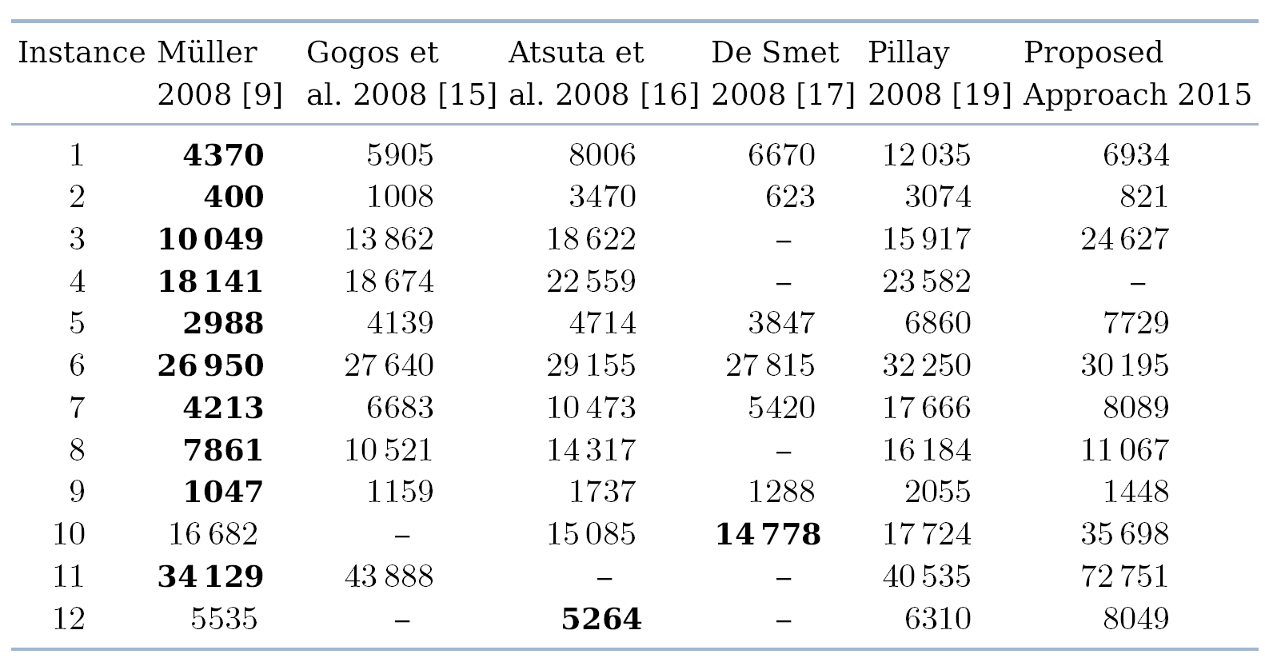
Experimental Results

Slide 23
The End
I hope you enjoyed it!
Any questions?

